Slide 1




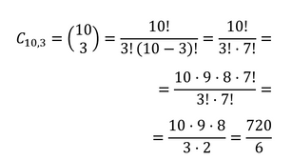




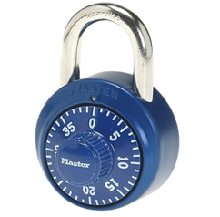

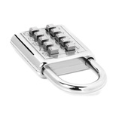


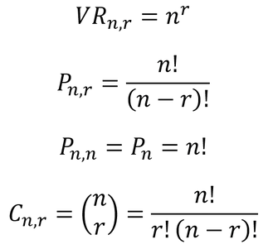









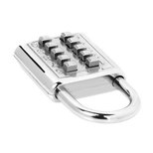
Combinations of 4 numbers can be chosen.
Each box has 10 elements.
A combination can have repeated elements.
Combinations of 3 numbers can be chosen.
Each box has 40 elements.
A combination cannot have repeated elements.
There are 10 keys to choose from, of which only 3 must be chosen.
Combinations with the same numbers, but out of order, count as the same combination.
Roulette numbering padlock
You can choose combinations of 4 elements ⬆️⬇️➡️⬅️
A combination cannot have repeated elements.
Directional padlock (restrictions)
Push-button padlock
Safe padlock
In how many different ways can we choose combinations with r squares and n elements in each square, if the combinations cannot repeat elements and the order of the elements is indifferent ?
In how many different ways can we choose codes? with r boxes in elements in each box and if we can repeat elements ?
In how many different ways can we choose codes with r boxes and n elements in each box, if we cannot repeat elements ?
In how many different ways can we sort a given code of n elements?
Answer the question...
Formula
Variation with repetition of n elements considered from r to r.
Variation without repetition of n elements considered from r to r.
(Particular case)
Combination of n elements considered from
r in r.
Model name
Permutation of n elements
Yes
No
CAN THEY BE REPEATED?
r boxes
n elements in each box
Yes
No
DOES IT INFLUENCE ORDER?

